Slide 1

Analysing the Impact of Air Quality on Public Health
Fatma Didem Meke 2361392
Burcu Nalbant 2502235
Ceren Şahin 2502367

Slide 2
Data Description
Air Quality and its Impact on Public Health
Kaggle -> Source: 🌍 Air Quality and Health Impact Dataset🌍
Removed Columns: RecordID, HospitalAdmissions, and HealthImpactClass.
5,811 observations and 15 variables -> 2000 observations and 12 variables

Slide 3
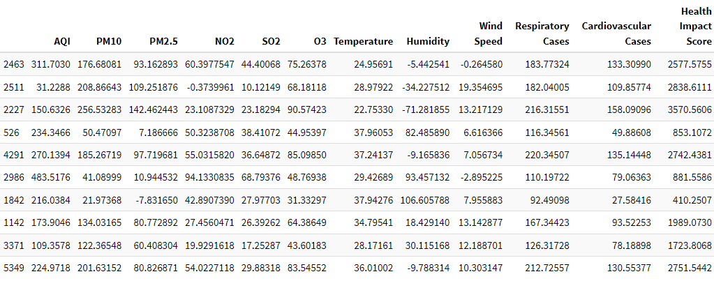
A Quick Look at the First 10 Rows

Slide 4
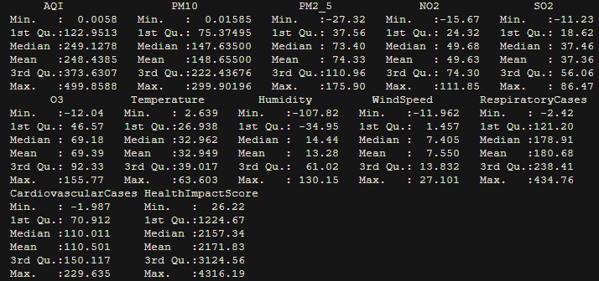
Summary Statistics

Slide 5
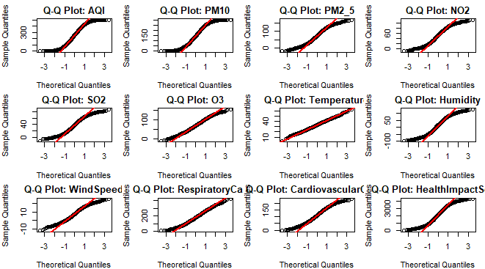
Normality Check Using Q-Q Plots

Slide 6
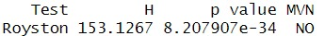
Multivariate Normality Check
H₀: The data has multivariate normality
P < 0.05 That’s why we reject H₀

Slide 7
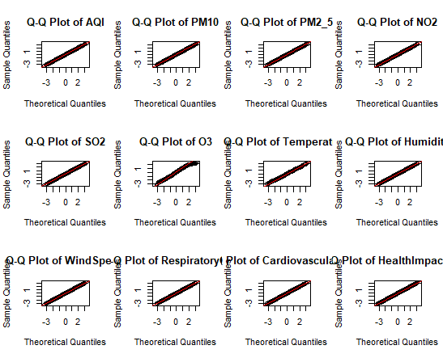

Slide 8
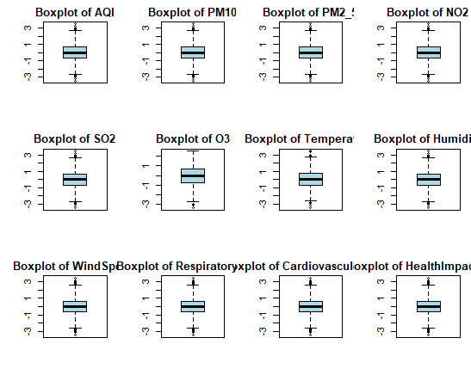
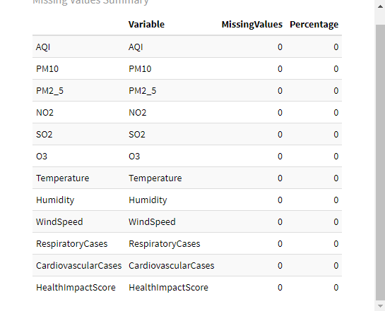
Boxplots for Outliers and Missing Data Summary

Slide 9
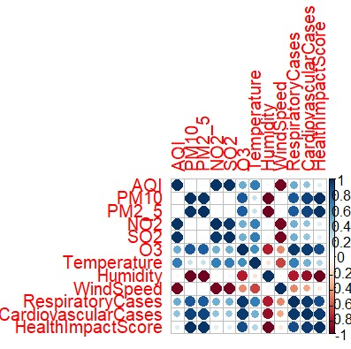
Correlation Matrix of Variables

Slide 10
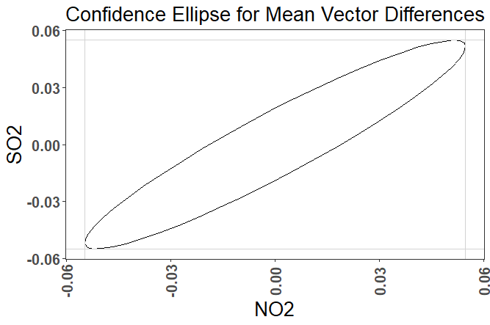
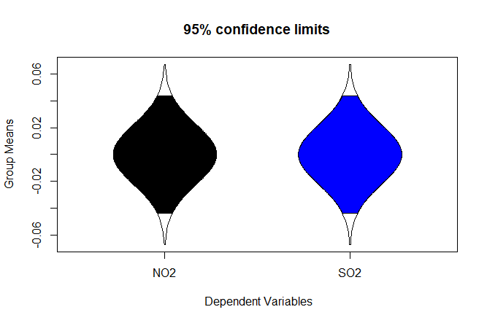
Inferences About a Mean Vector: Air Pollutant Levels vs. Benchmarks
H₀: µ = µ₀ (The pollutant levels are equal to the safety limits).
H₁: µ ≠ µ₀ (The pollutant levels are not equal to the safety limits).

Slide 11
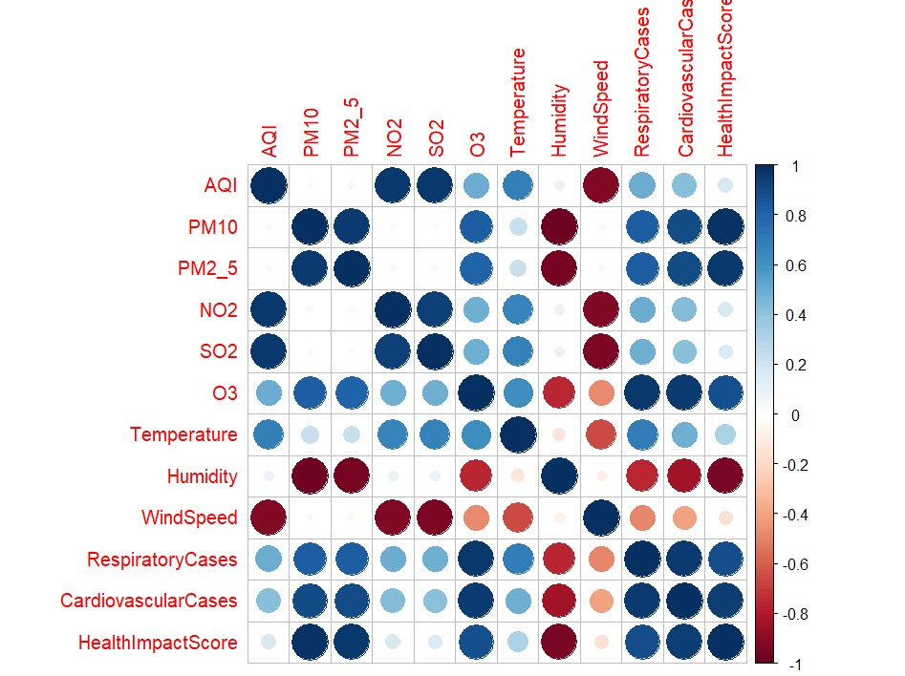
Principle Component Analysis
Principle component analysis can be useful when we have multicollinearity problem.

Slide 12
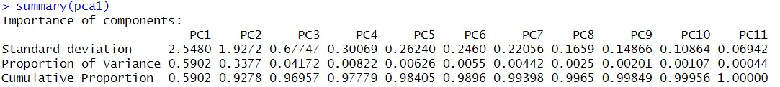
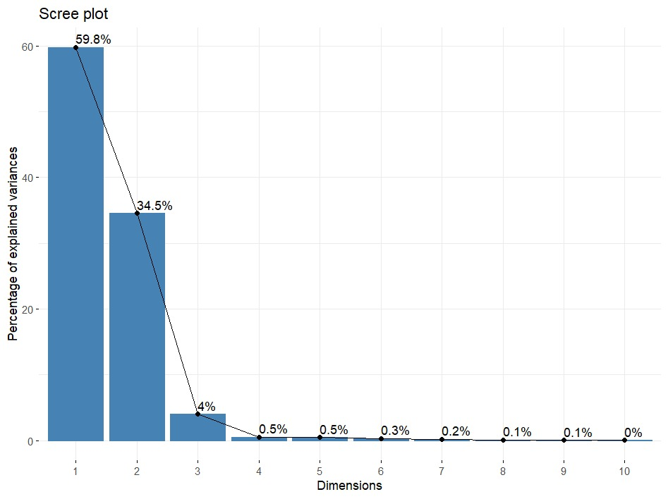
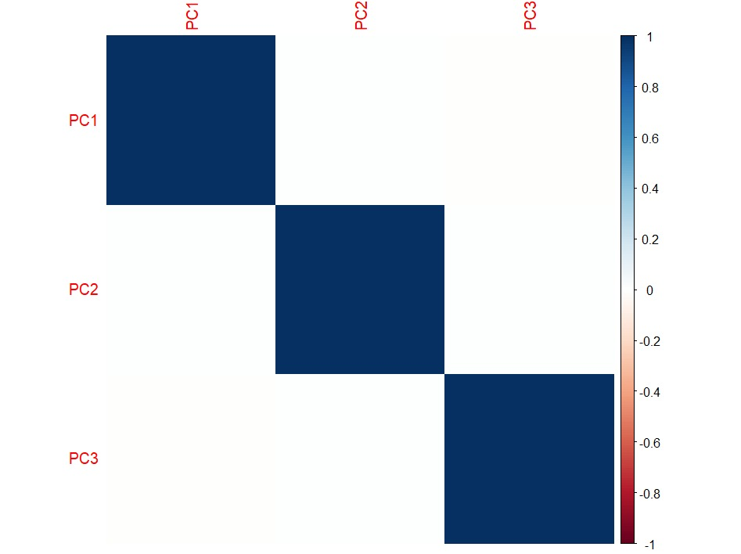

Slide 13
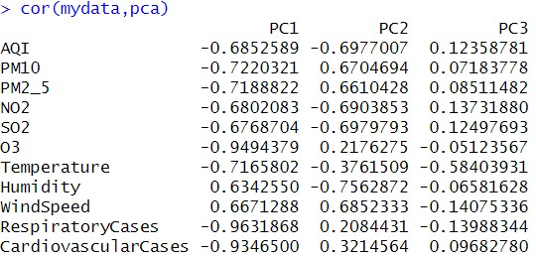
We may observe the correlation between components and variables. For instance, the first component is positively correlated with Humidity and Wind Speed, indicating that these variables increase or decrease together. Conversely, the first component is strongly negatively correlated with Respiratory Cases, with a coefficient of -0.96, suggesting an inverse relationship.

Slide 14
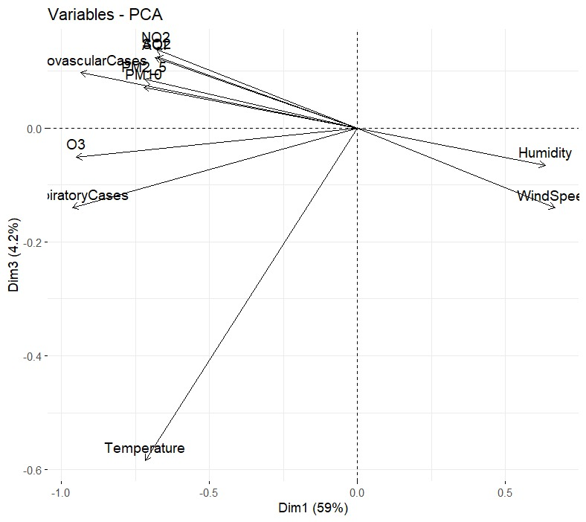
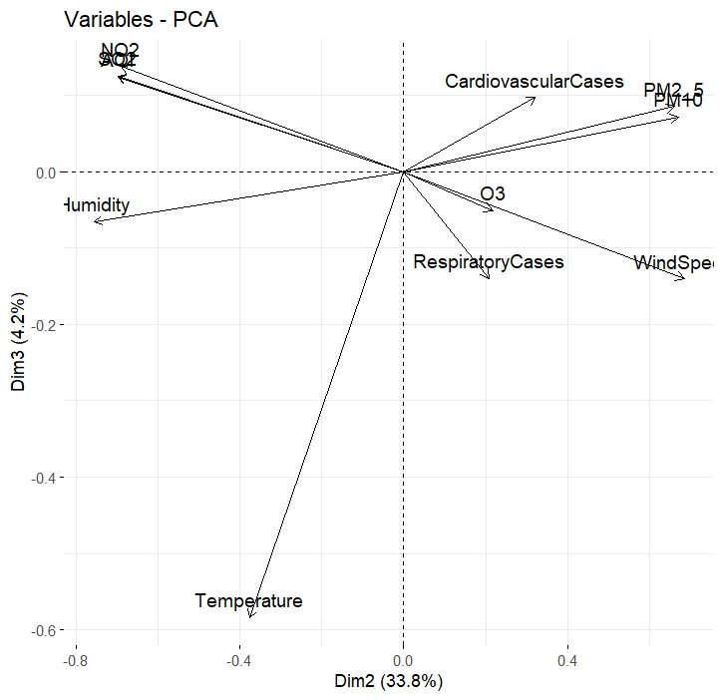
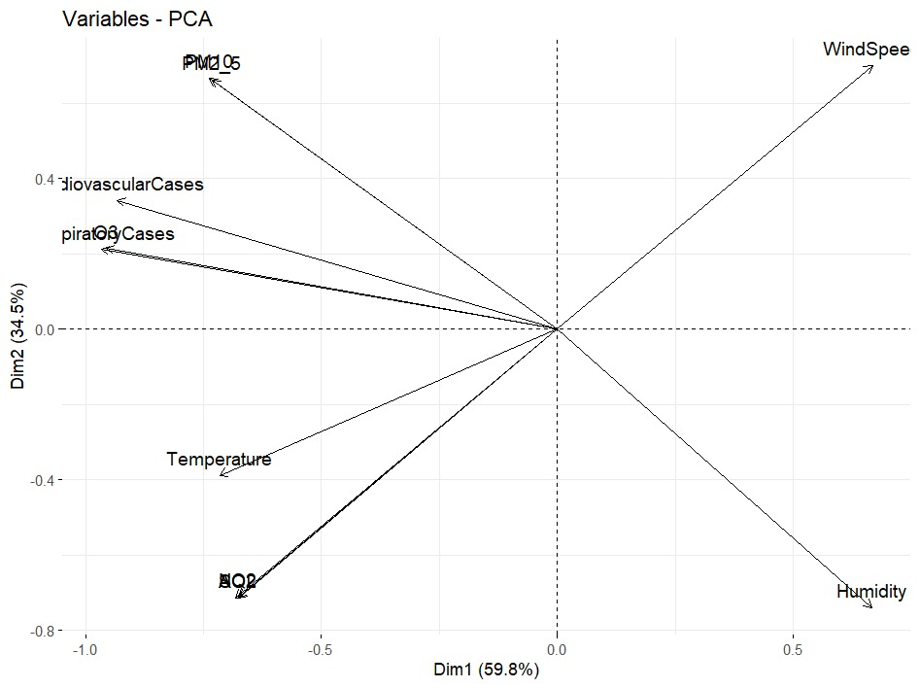
Principal Component Analysis: Variable Directions

Slide 15
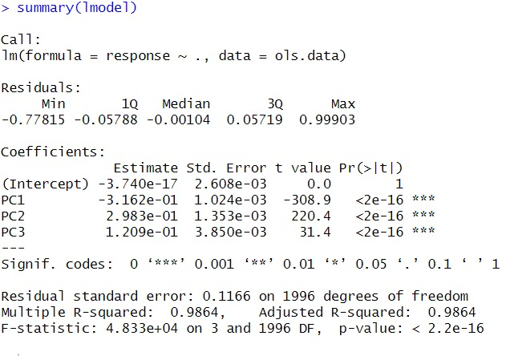
Principal Component Regression
HealthImpactScore=−3.740×10^−17−0.3162⋅PC1+0.2983⋅PC2+0.1209⋅PC3

Slide 16
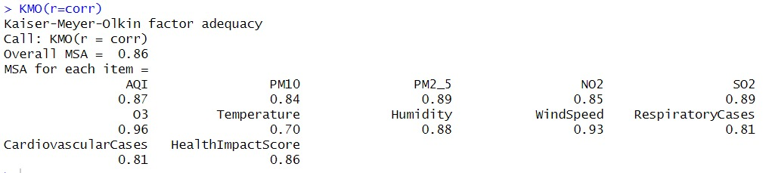
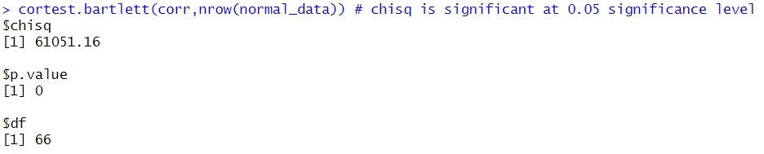
Factor Analysis

Slide 17
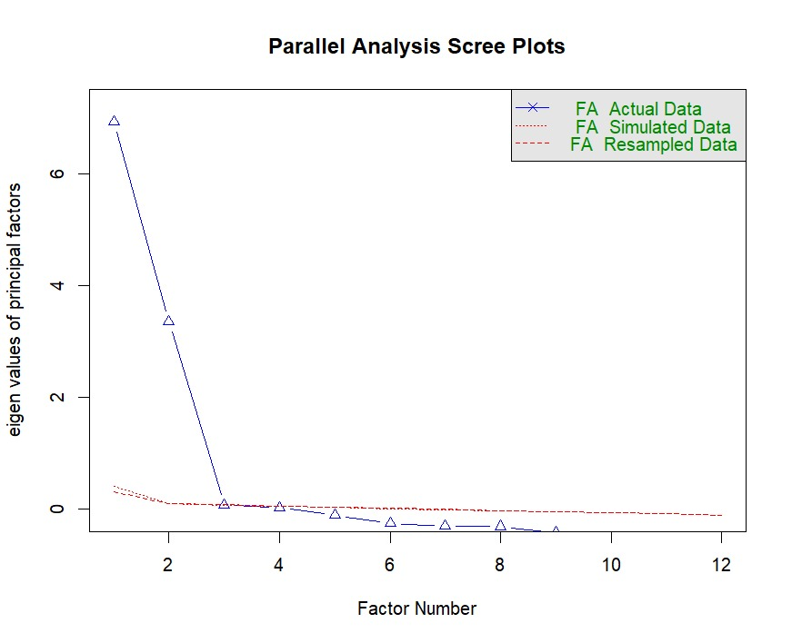
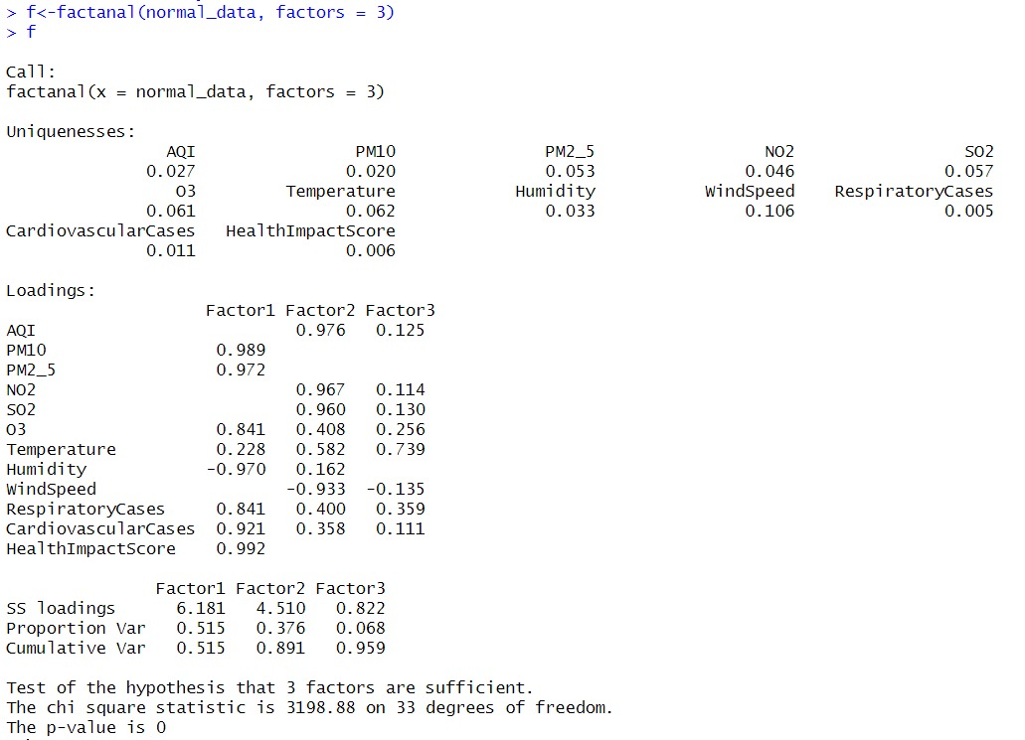
H₀: 3 factors are sufficient

Slide 18
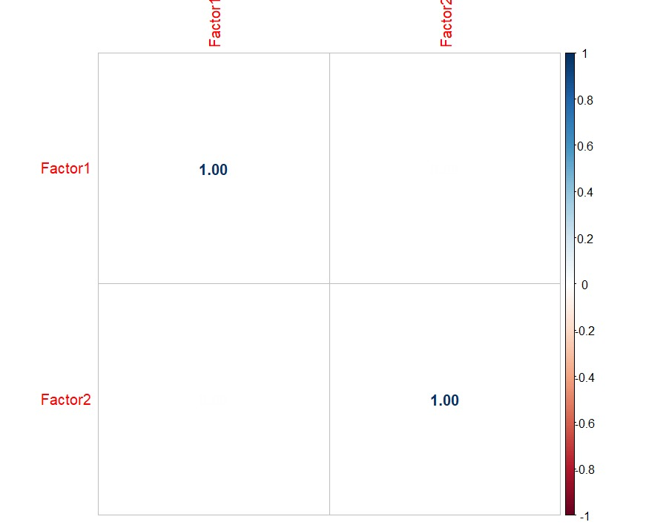
There is no multicollinearity problem.
Raw alpha shows how consistent the variables are within factor.

Slide 19
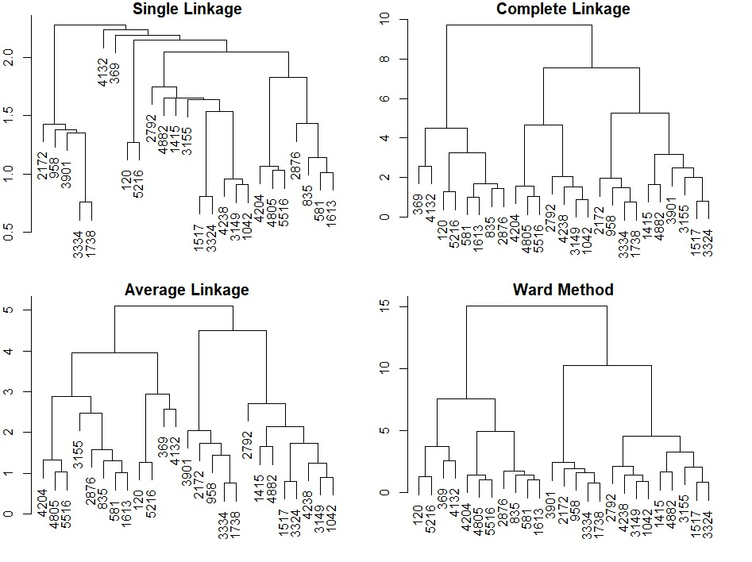
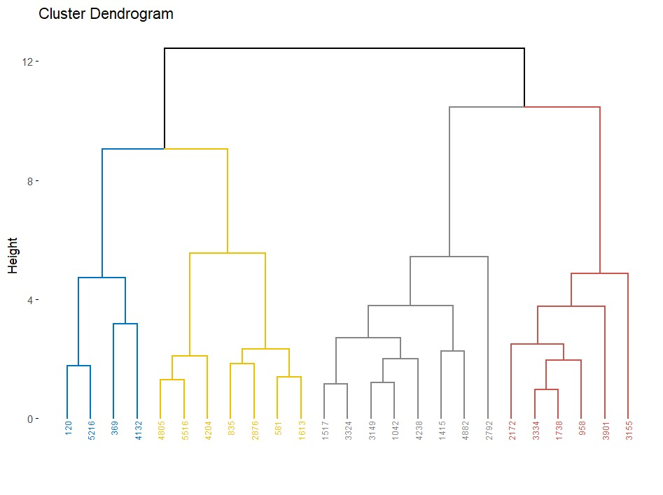
Comparison of Clustering Methods
Agglomerative Hierarchical Clustering
Divisive Hierarchical Clustering

Slide 20
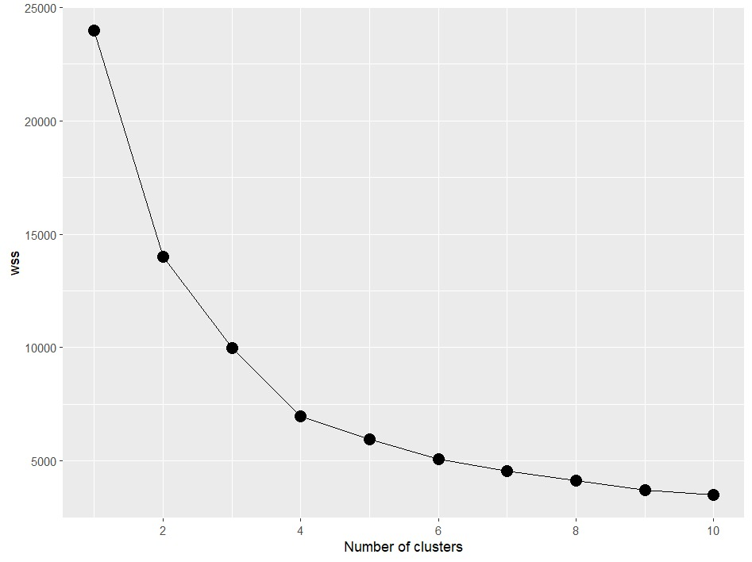
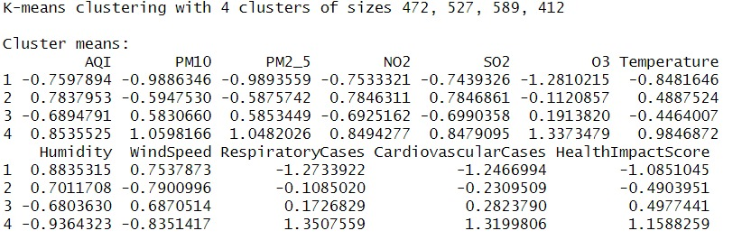
Optimal Number of Clusters
As we can see k=4 as the within-cluster sum of squares
began to decrease at a slower rate beyond k=4

Slide 21
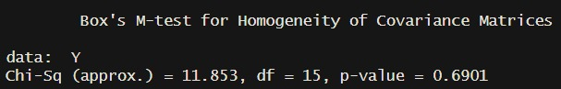
MANOVA
We used temperature column and columns of pollutants (PM10,PM2_5,SO2,NO2,O3)
We divided temperature column into three categories
From -9.99 to 15’ | LOW
From 15 to 25 | MEDIUM
From 25 to 40 | HIGH
Equality of Variance

Slide 22

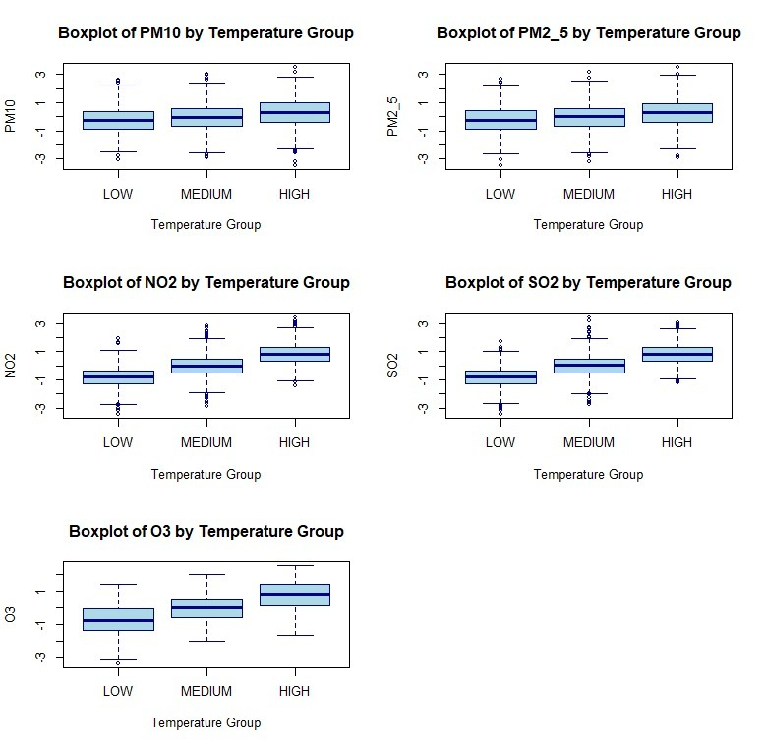
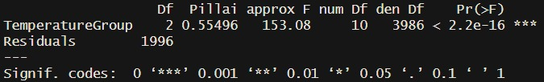
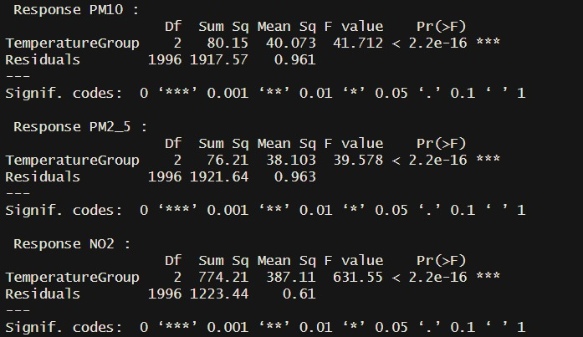
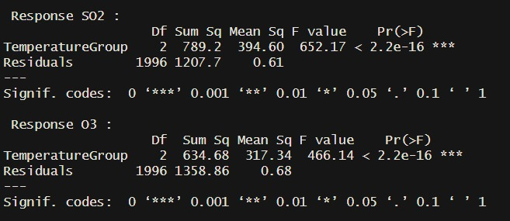
Output of MANOVA
H₀: All means of pollutants are the same across temperature ranges.
H₁: At least one differs.

Slide 23
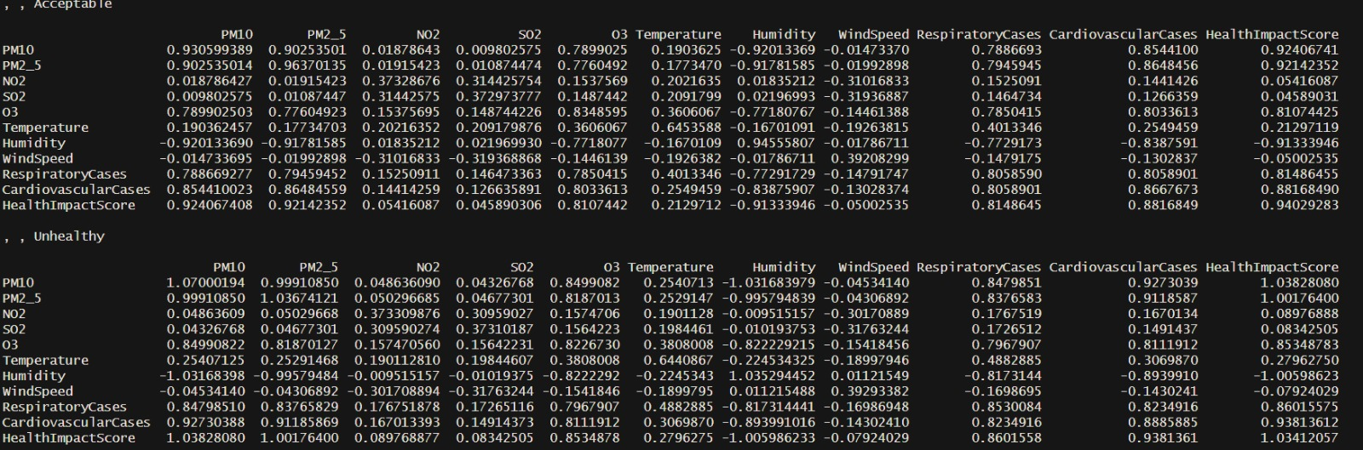
Discrimination & Classification
AQI Column
2 Different Categories Acceptable & Unhealthy
There is NOT much difference between covariance of two groups

Slide 24
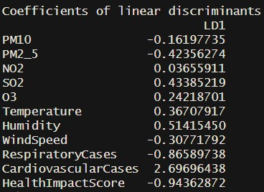
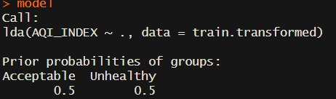
Linear Discriminant Analysis
Coefficient Table:
First Probabilities:
LDA1= (-0.16196677xPM10)+(0.42545610xPM2_5)+.....+(0.94498446xHealthImpactScore)
Overall accuracy is 0,96

Slide 25
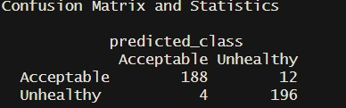
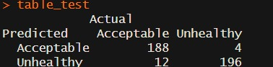
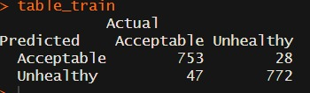
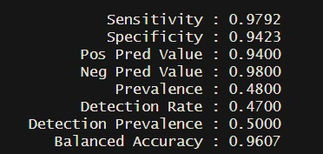
Confusion Matrices
Overall Confusion Matrix
Test Performance
Accuracy is 0.96
Train Performance
Sensitivity & Specificity
Accuracy is 0.95

Slide 26
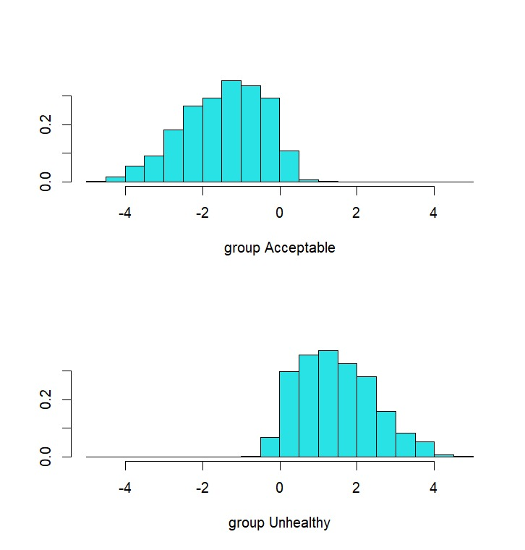
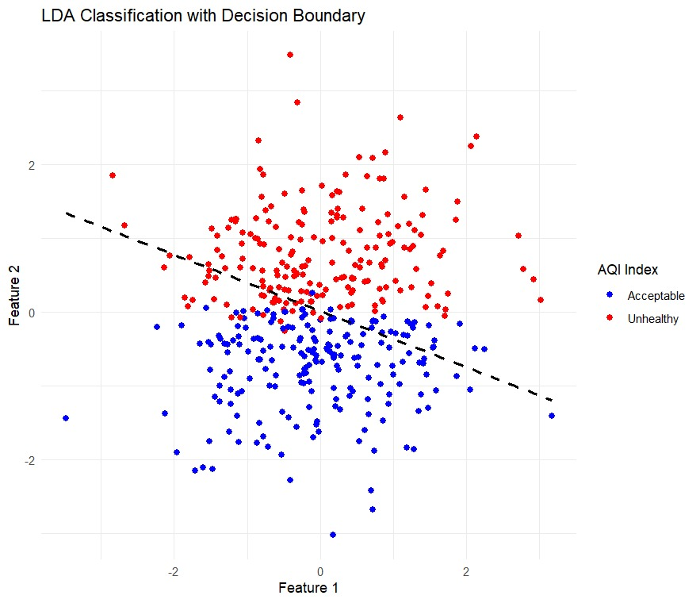
Air Quality Classification Using LDA

Slide 27
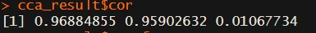
Canonical Correlation
X | Y
NO2, SO2, O3 | Temperature, Humidity, WindSpeed

Slide 28
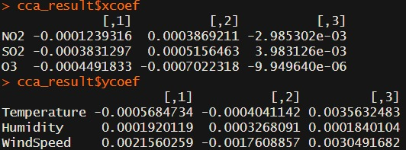
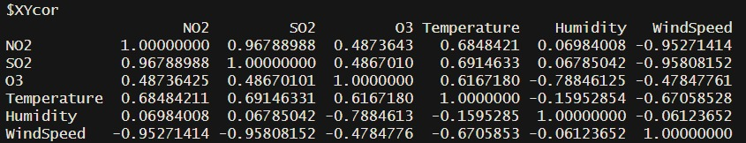
Coefficient of Canonical Variate
X-Y Corelation Matrix
Temperature increases pollutants
WindSpeed reduces pollutants
Humidity sspecifically impact Ozone

Slide 29
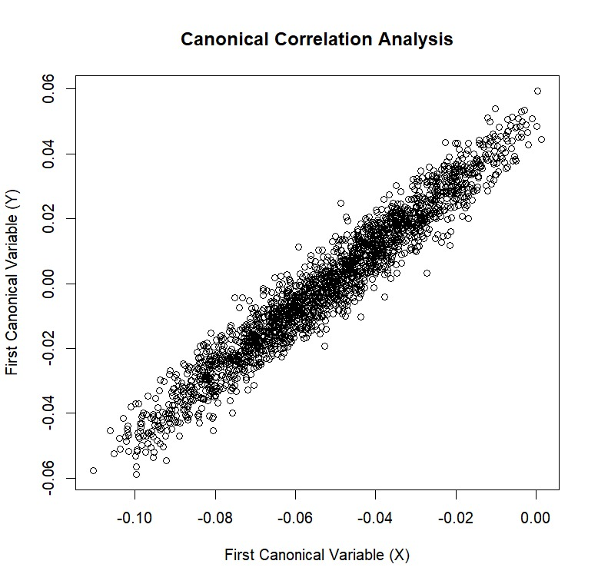

Slide 30
References
El Kharoua, R. (n.d.). Air Quality and Health Impact Dataset. Kaggle. https://www.kaggle.com/datasets/rabieelkharoua/air-quality-and-health-impact-dataset/data

Slide 31

Thank you so much 🐱

